Slide 1

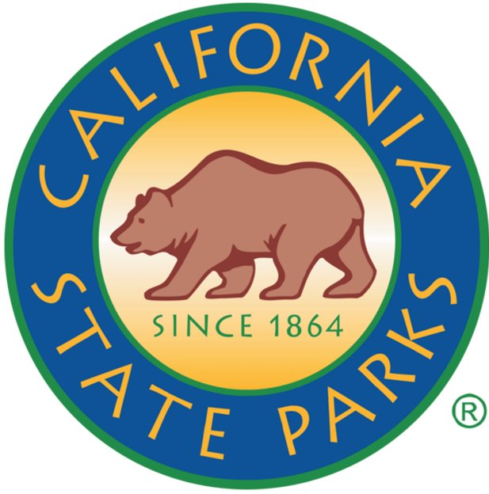
This project was partially funded by the Land and Water Conservation Fund through the U.S. Department of Interior and the California Department of Parks and Recreation.

